Slide 1

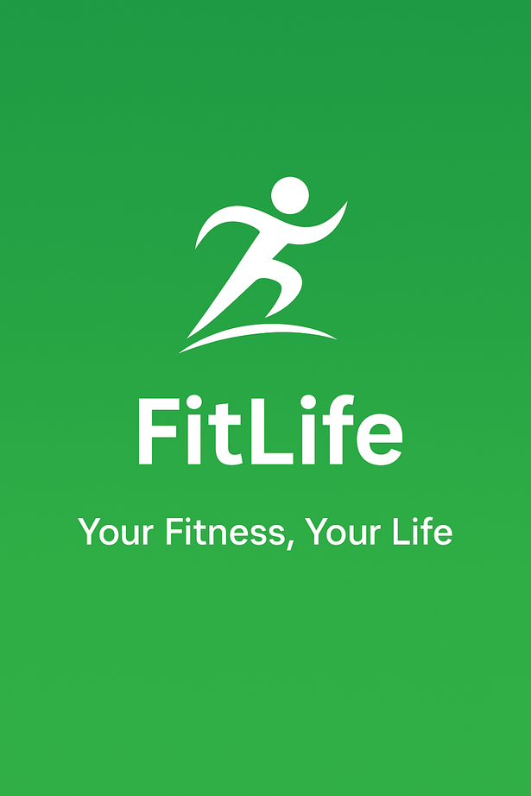
FitLife
FITNESS APP
Project Mentor-
Mrs.Kirti Vijayvargia(Assistant Professor)
By-
Yuvraj Pandey

Slide 2
INTRODUCTION
Fitlife is a health and fitness mobile application.
Aims to promote balanced and active lifestyle.
Offers features like:
-Workout routines.
-Diet and nutrition tips
-Progress tracking and goal setting.
Suitable for all fitness levels-from beginners to pros.
Designed for ease of use and long term habil buildings.

Slide 3
Technology Stack & Tools Used
Development Environment:
Android Studio – used for app development, UI design, and testing
Programming Language:
Java – used to implement app logic, navigation, and backend functionality
UI Design:
XML – used for designing layouts of screens like Home, Workouts, Profile, etc.
Architecture Pattern:
Follows MVC (Model-View-Controller) for clean code separation
Tools & Libraries Used :
Glide (for image loading), Material Components, etc.
Database:
SQL – to store user data and progress tracking

Slide 4
FitLife App User Flow
1.User opens the FitLife app.
2.Registration/Login:
If new user → Goes to Registration Page
Enters name, age, gender, email, password, and goals
Clicks Register → Redirects to Home Page
If existing user → Goes to Login Page
Enters email and password
Clicks Login → Redirects to Home Page

Slide 5
3. Home Page:
Acts as the main dashboard
Contains navigation options:
Profile
Workouts
Progress
Help & Support
Logout
4. Profile Page:
Displays user's personal details
Option to edit or update fitness goals and personal info

Slide 6
5.Workout Section:
User selects from three workout categories:
💪 Strength Training
🏃 Cardio
🧘 Yoga
Each category contains:
List of exercises
Details: reps, sets, duration, and images
Start Workout button to begin session

Slide 7
6. Progress Page:
Shows visual charts or graphs
Tracks:
Total workouts done
Weekly/monthly progress
Goal completion
7. Help & Support:
Provides FAQs
Feedback form
Contact option for support
8.Logout:
Ends user session
Redirects to login/launch screen

Slide 8
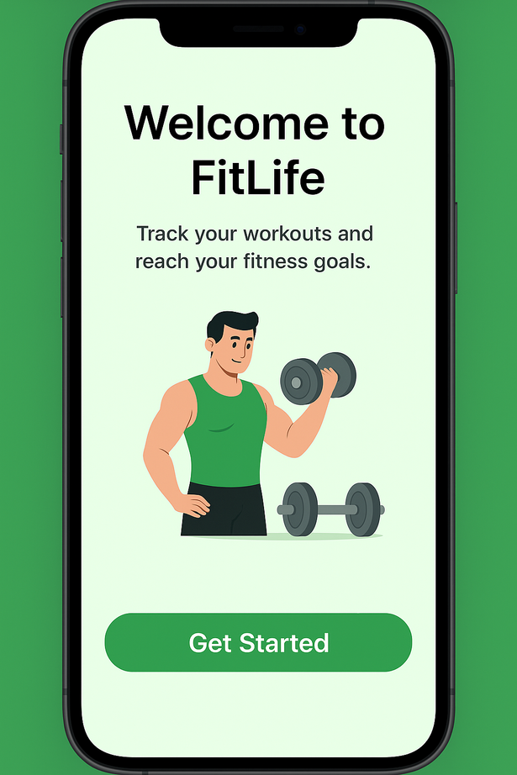
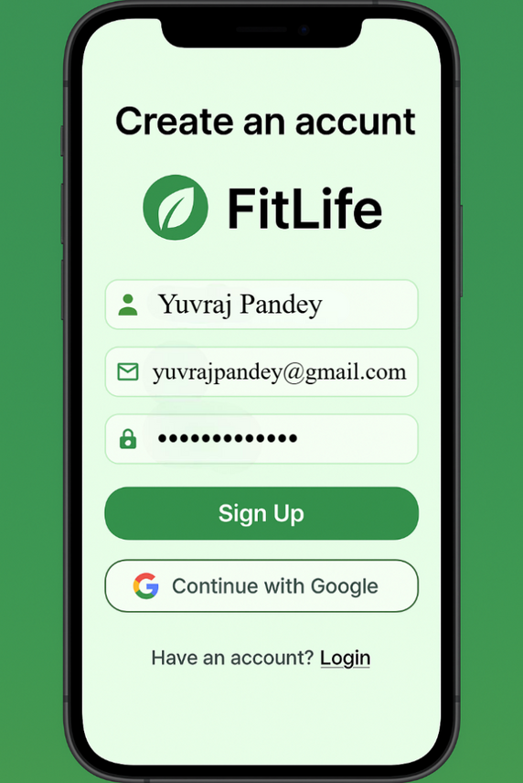
APP PREVIEW
Home Page
Registration Page

Slide 9
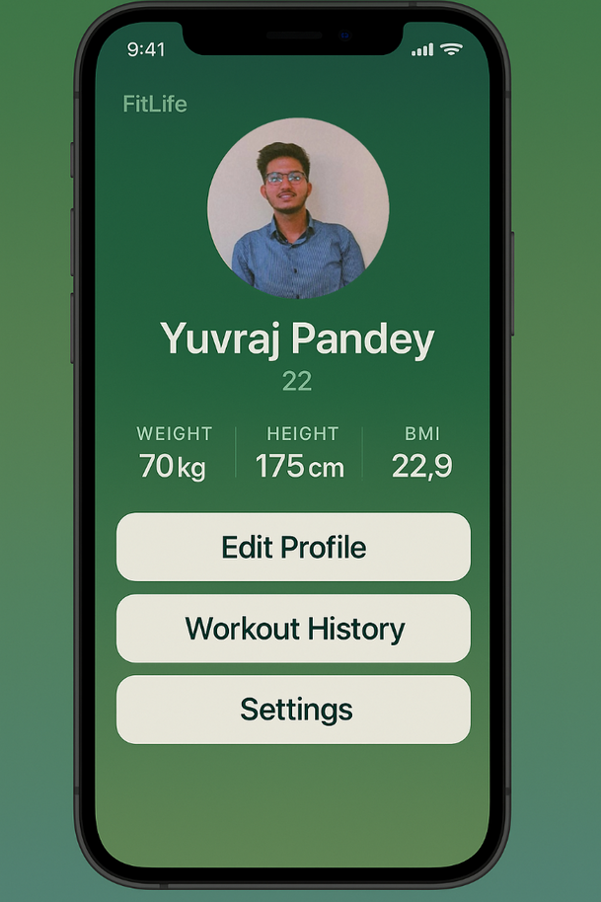
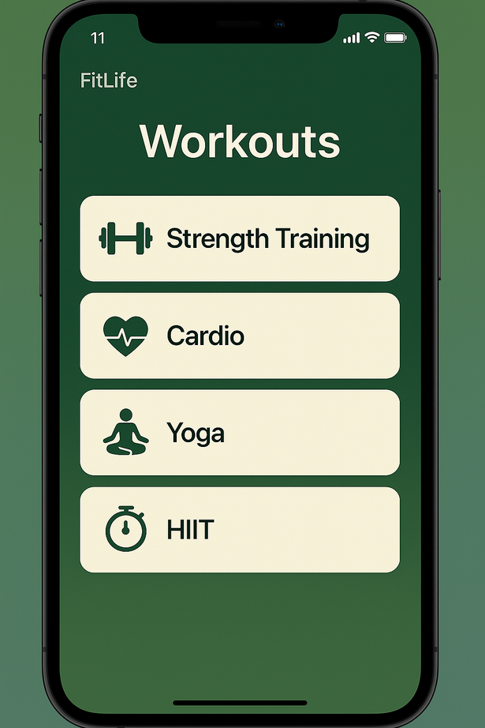
Profile
Workouts

Slide 10
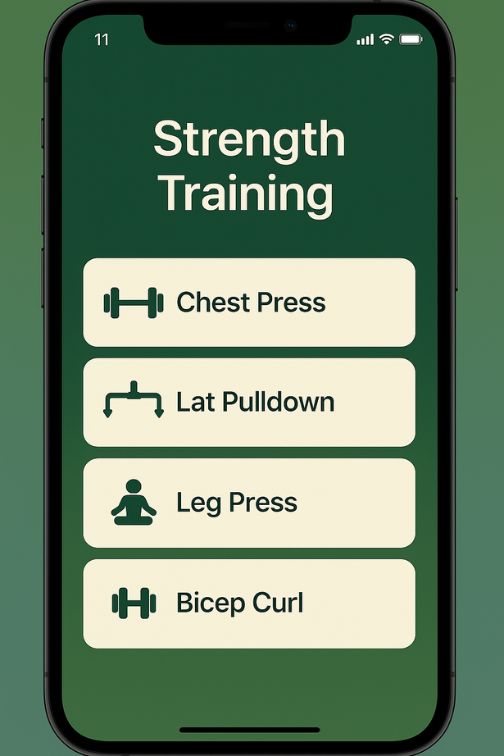
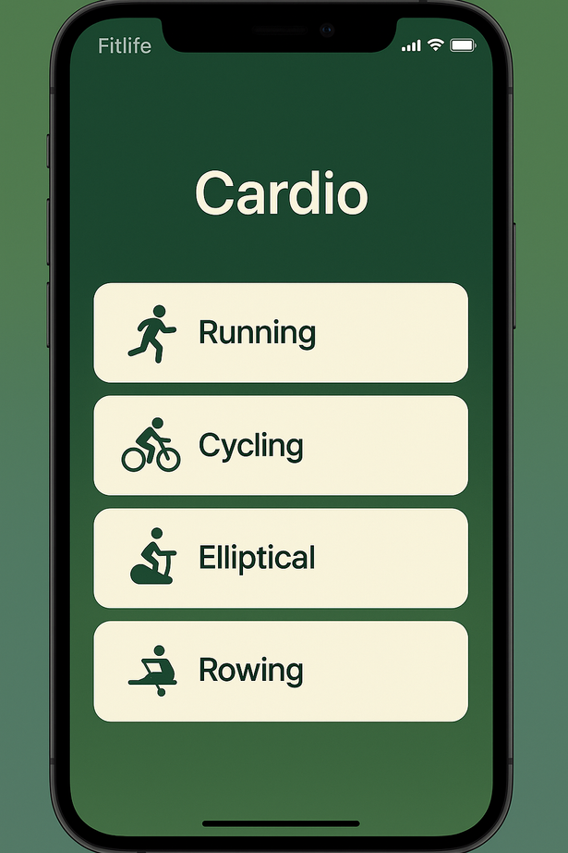
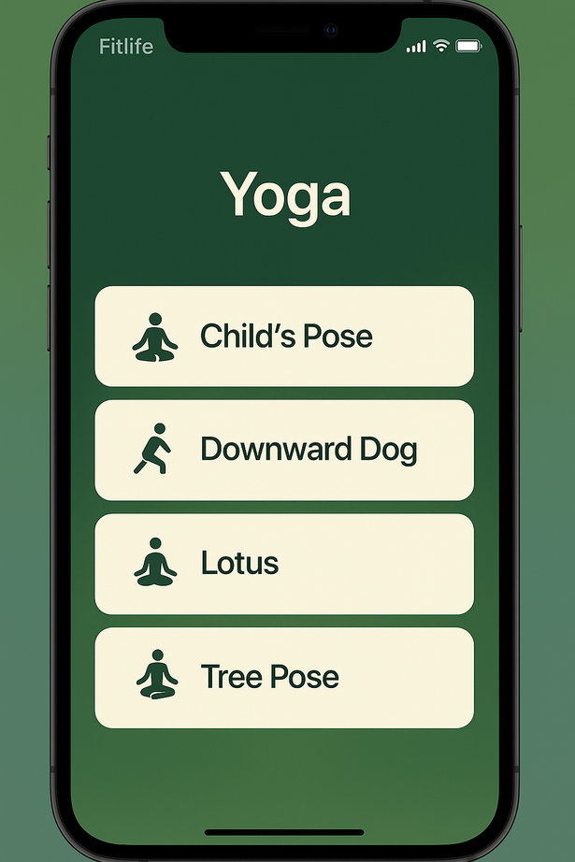
Strength Training Page
Cardio Page
Yoga Page

Slide 11
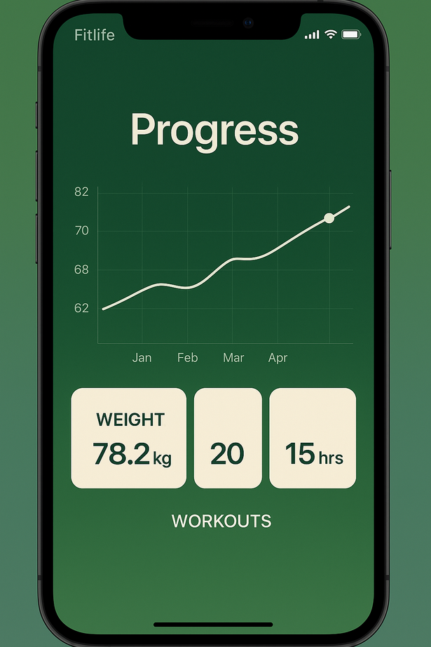
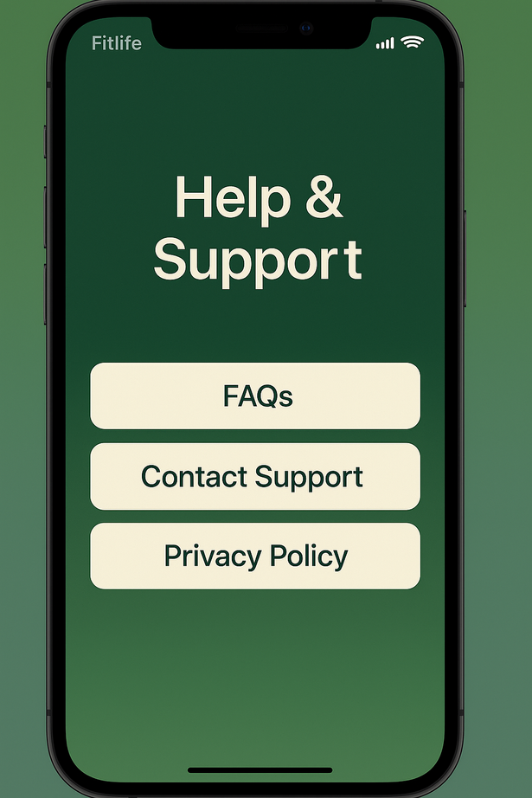
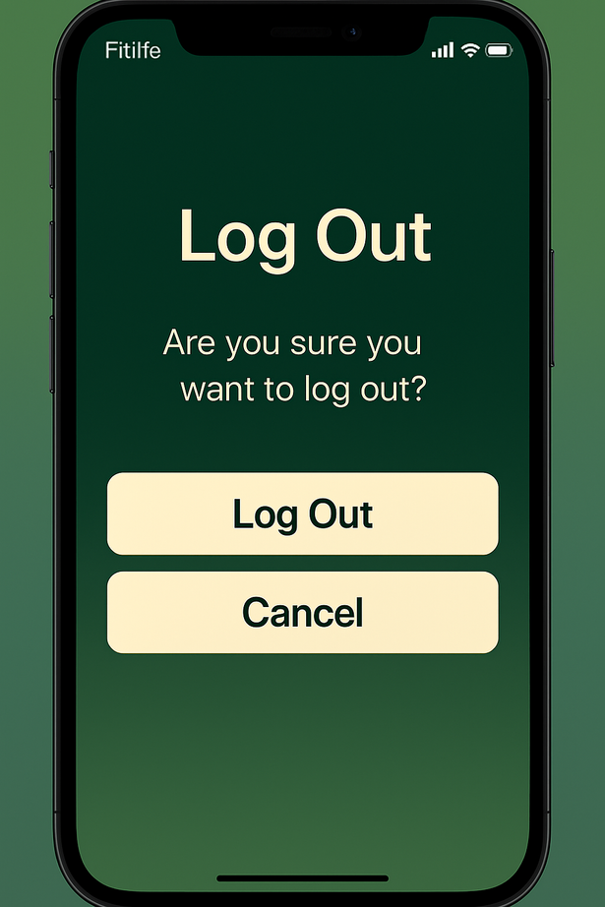
Progress Report
Help & Support Page
Log Out Page

Slide 12
My Role in the FitLife Project
👨‍🎨 UI Design & Screen Development
Designed and developed major screens using XML in Android Studio
Home Page, Profile Page, Workout Section, and Progress Page
🔄 Navigation
Implemented smooth navigation between screens using Java Intents.
🔐 Authentication Functionality
Created Registration and Login features

Slide 13
📈 Progress Tracking UI
Designed a layout to represent user workout progress
🛠️ Testing & Debugging (During Development)
Tested screens and features locally using emulator
Checked user flows like registration, login, and workout navigation
Identified and fixed layout issues and logic errors during development

Slide 14
🆕 Future Enhancements in FitLife 💡
🤖 AI-Powered Fitness Coach
Smart assistant to give instant guidance and modify plans in real-time.
📸 Posture Detection via Camera
Use mobile camera to correct user posture during workouts to prevent injuries.

Slide 15
🎵 Custom Music Sync
Auto-generate workout playlists from Spotify/YouTube based on workout intensity.
🚨 Emergency Health Alert System
If abnormal heart rate or sudden inactivity detected during workout, send alert to emergency contact
🛒 Fitness Marketplace
Built-in store for fitness gear, supplements, or books

Slide 16

THANK YOU

